Slide 1
Predict Interest Rates
Atharva, Poonam, Upvandeep, Brian, Balaji

Slide 2
Goal
Meaningful analysis on Prediction Interest Rates dataset.
Understanding the patterns of lending based on historical data.
Calculate the RMSE for the prediction
Creating data visualizations to display insights

Slide 3
Data Exploration
Predict Interest Rates
Column Identification and Segregation
Analyzing data Patterns
Exploratory Data Analysis
Data Exploration
Process
Statistical Analysis
Knowledge & Data Discovery
Creation of target dataset

Slide 4
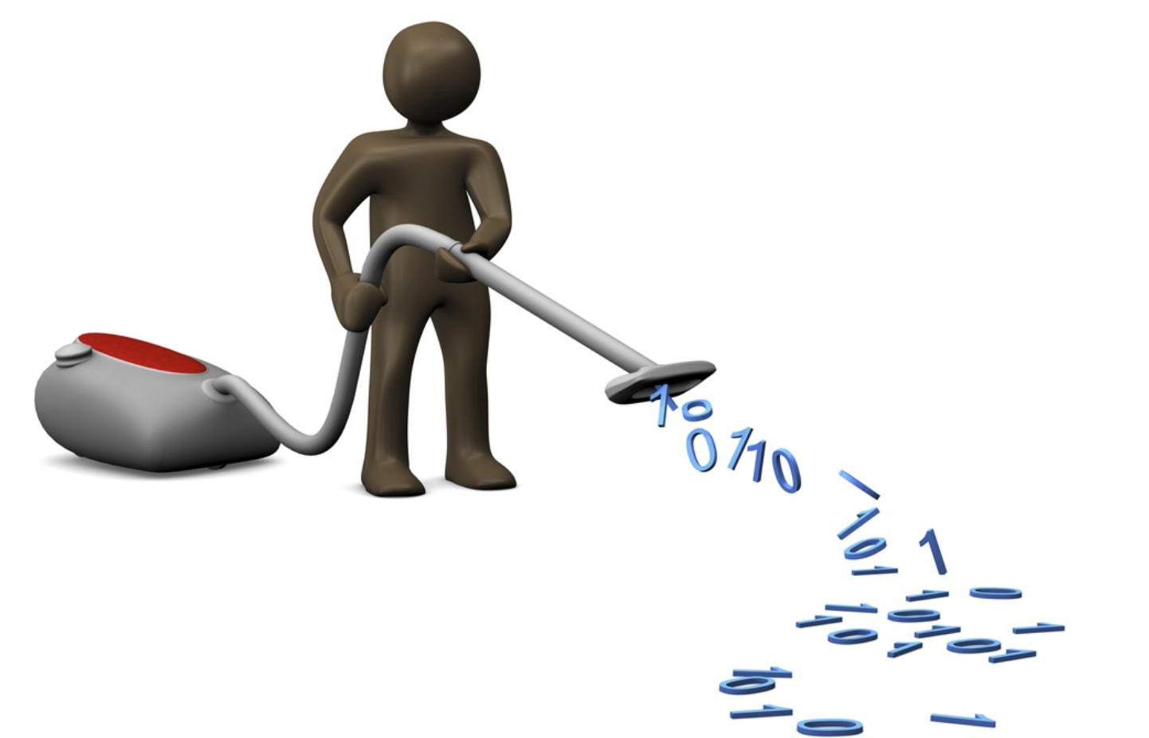
Data Cleaning and Preprocessing
Data Wrangling and Cleaning of the Data Set
Detection and Treat of outliers
Missing Values Imputation
Data Cleaning
Remove noise and Outliers
Normalization of the raw data

Slide 5
Feature Engineering
Categorical Encoding
Feature Scaling
Variable Transformation
Accuracy improvement of the models by tuning or converting the categorical data.
Regularization of loss function
Transforming the input data set to the suitable model training format.
1
2
3

Slide 6
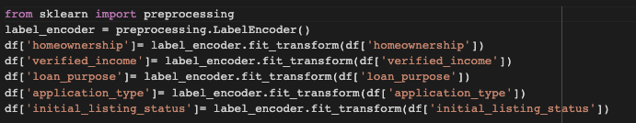
Feature Engineering
Categorical Encoding
Accuracy improvement of the models by tuning or converting the categorical data.
1
Encoded Categorical Data - Homeownership - Verified Income - Loan Purpose - Application Type - Initial Listing Status

Slide 7
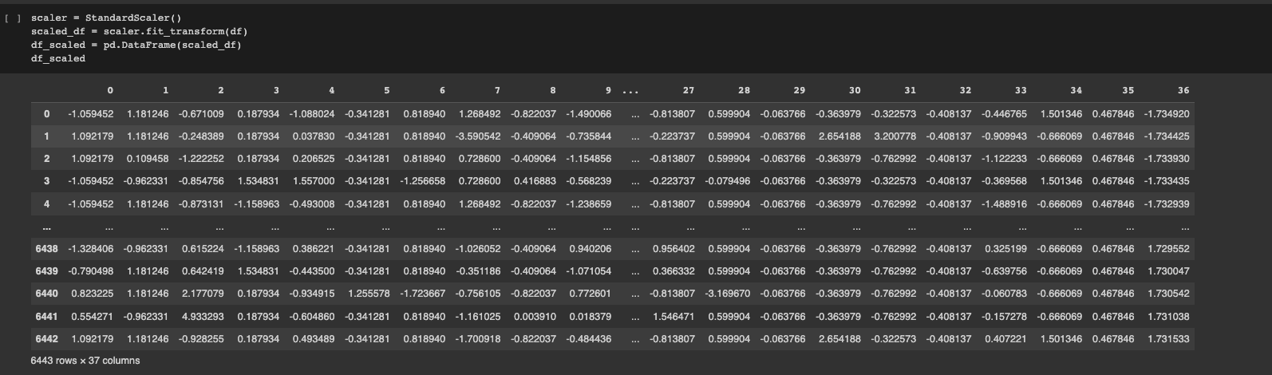
Feature Engineering
Feature Scaling
Scaled Features using sklearn StandardScaler
Regularization of loss function
2

Slide 8
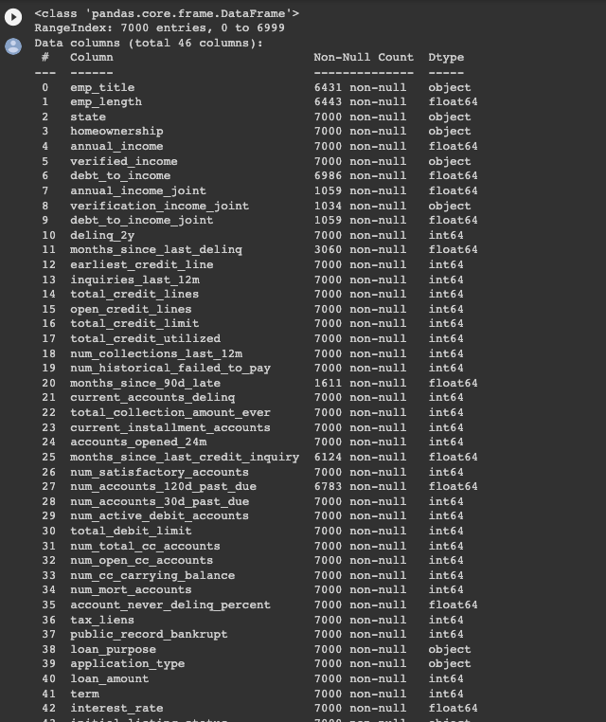
Feature Engineering
Numerical columns already in correct data type for modeling
Categorical columns encoded to become numerical values
Variable Transformation
Transforming the input data set to the suitable model training format.
3
80/20 Split used for Training Set
X_train, X_test, y_train, y_test = train_test_split(X,y,test_size=0.2, random_state=42)

Slide 9
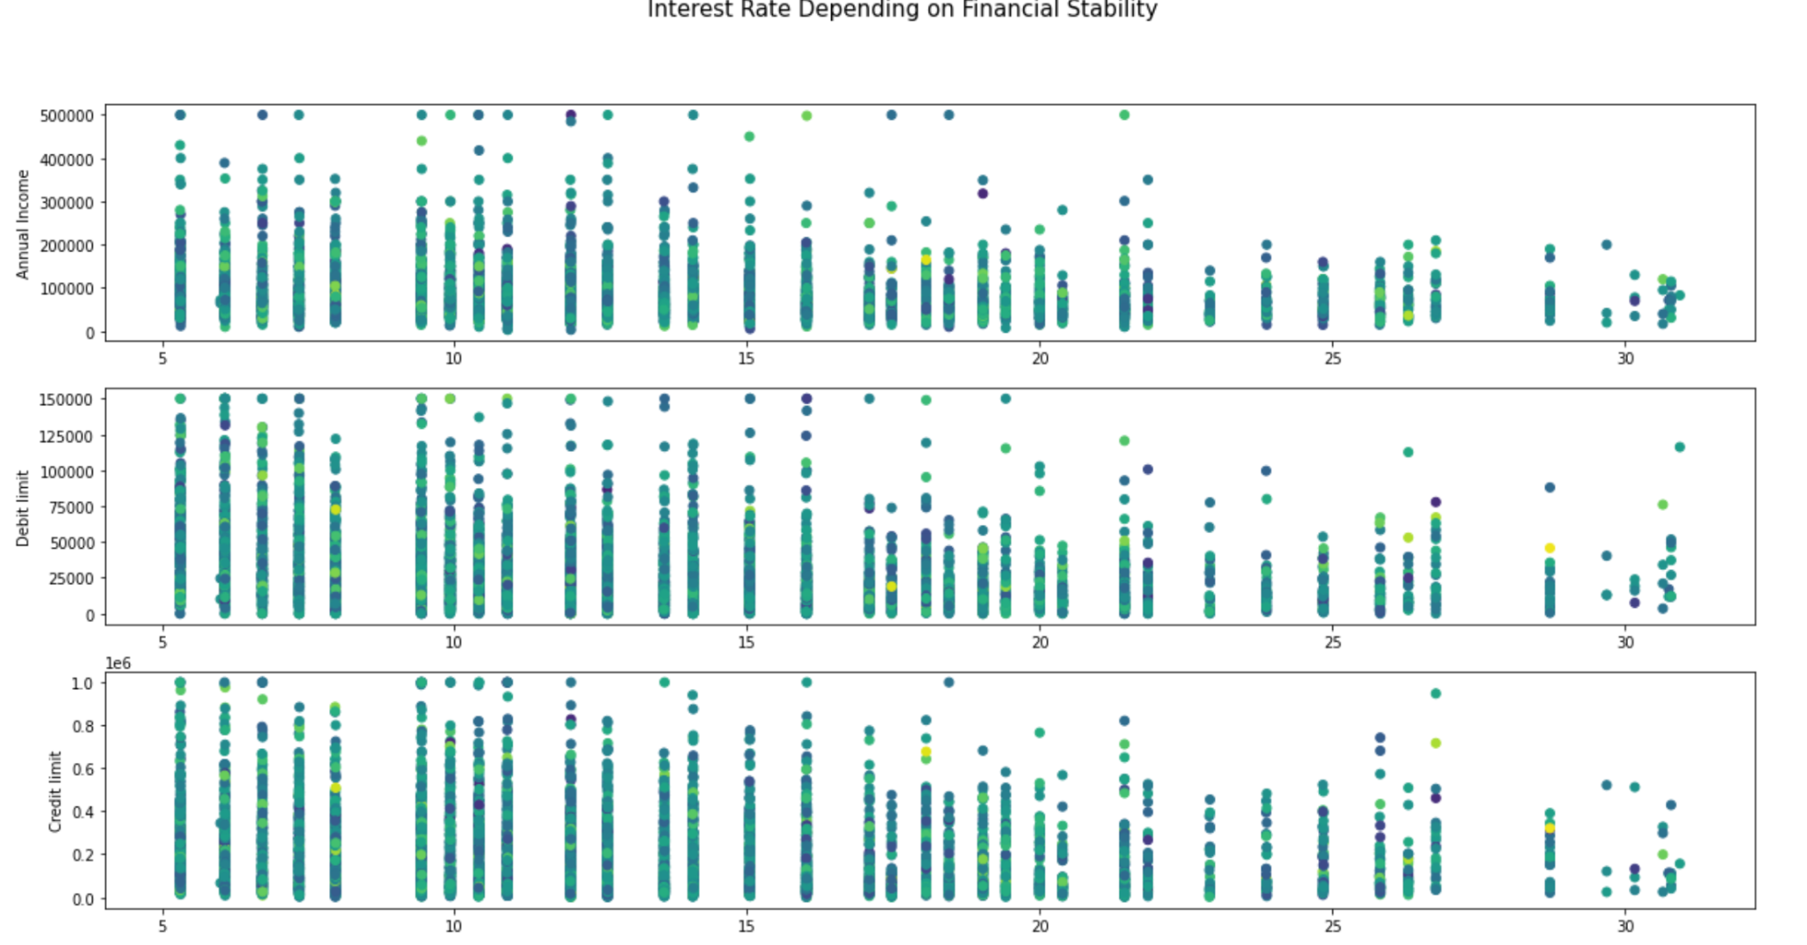
Visualization
The visualisation clearly illustrates the negative correlation between financial stability and interest rate
Better the income and credit/debit limit, lower the interest rate

Slide 10
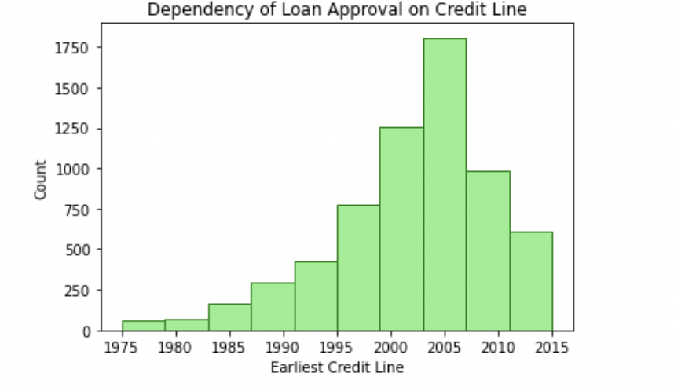
Visualization
Loan Approval directly depends on the Earliest Credit line. More number of loans are approved for employees having their earliest credit line between 2000 to 2010. This makes sense because the older and newer employees may not be as credible when compared to the optimal range

Slide 11
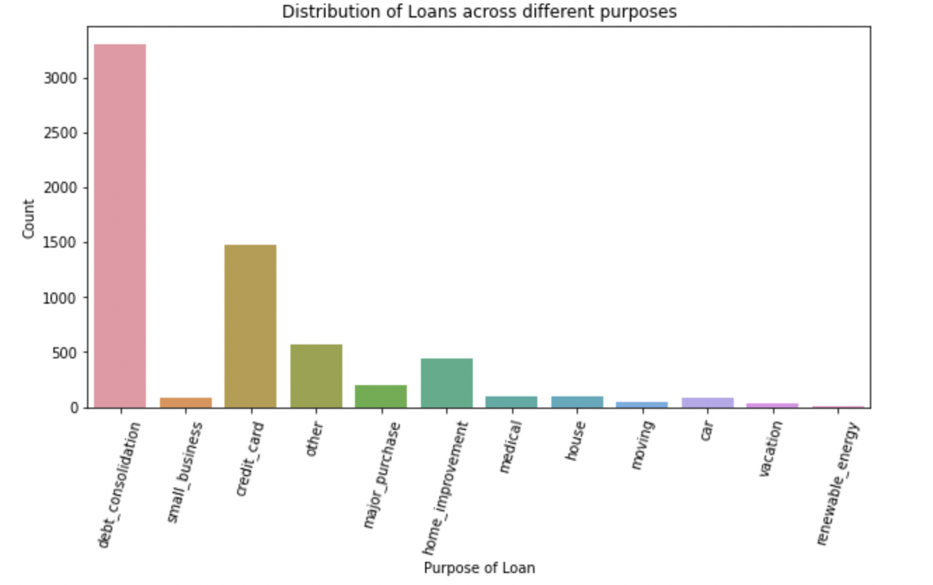
Visualization
This visualisation provides a great idea of the various reasons for which employees generally apply for loans. Its observed that debt consolidation is the main reason for loan applications

Slide 12
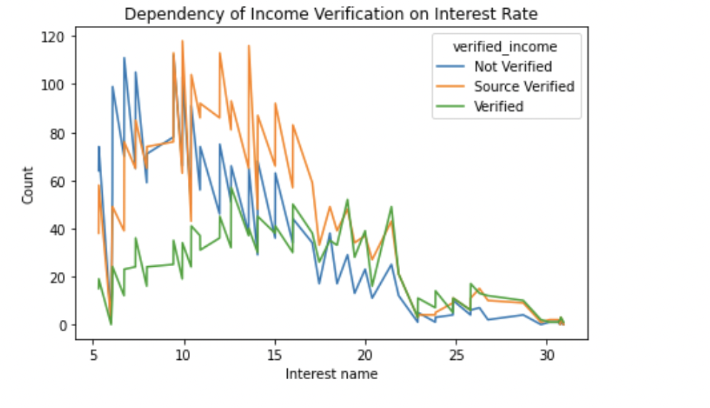
Visualization
It’s critical to understand that a verified source of income will definitely lead to a lower rate of interest. The same is projected by the visualisation

Slide 13
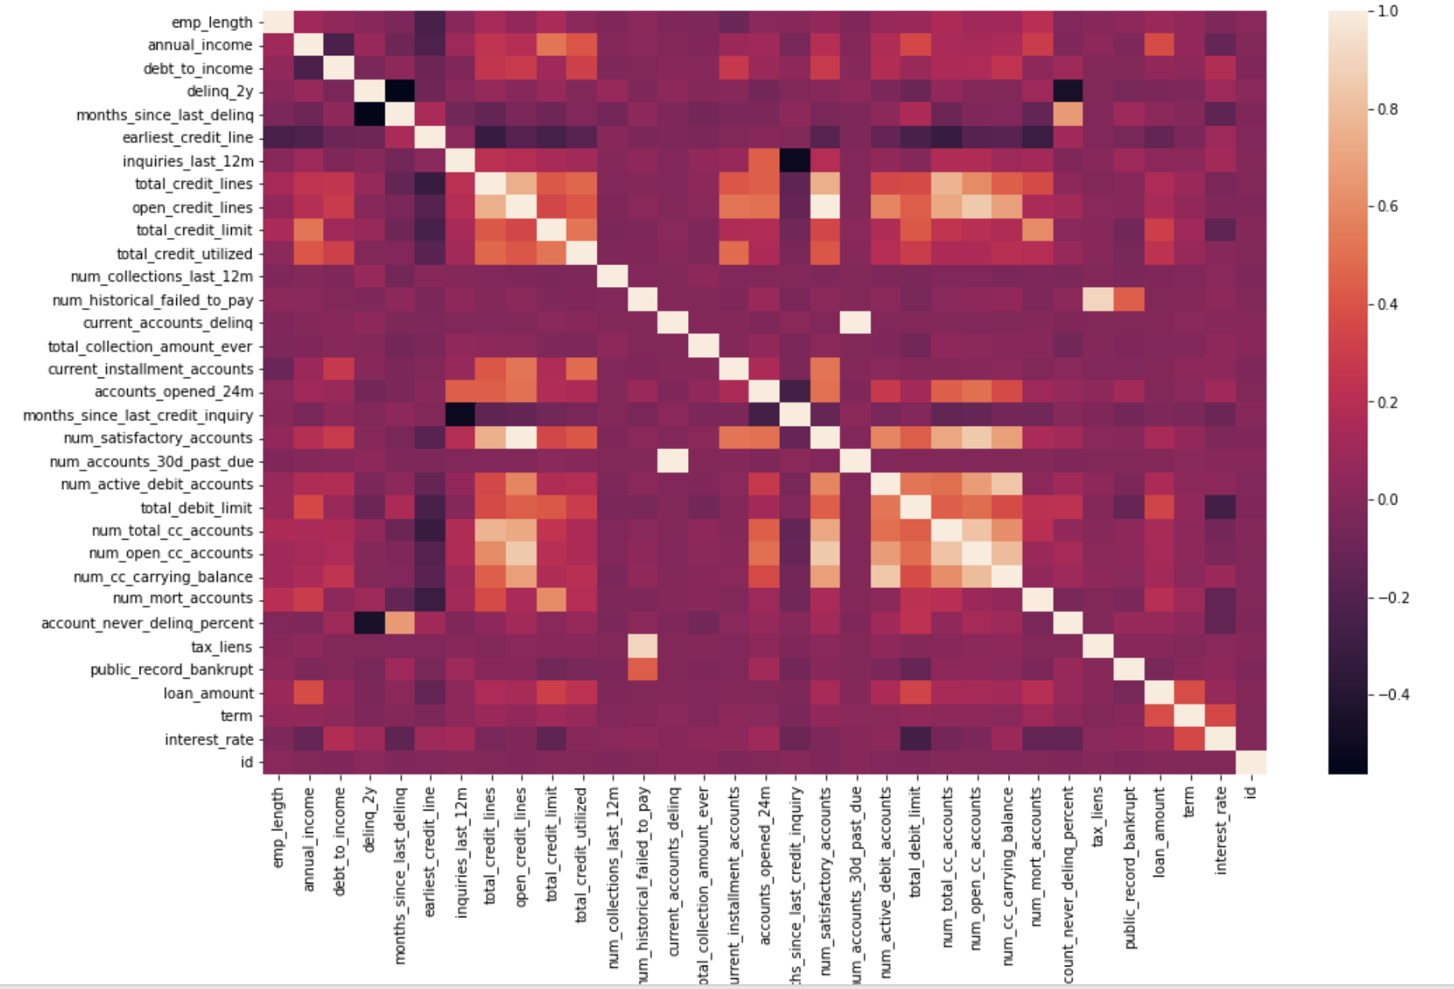
Visualization
The correlation matrix helps us understand the relationship and the intensity of all the parameters on interest rates

Slide 14
Modeling
Different Models Used :
Linear Regression
Random Forest Regression
KNN
XGBoost Regression
The accuracy of XGBoost Regression was better than other models.
Why XGBoost ?
It can handle outliers
Handles Missing values

Slide 15
Hyperparameter Tuning
Finding a set of optimal hyperparameter values essential to increase the accuracy of the model.
Technique Used :
RandomSearchCV

Slide 16
Accuracy Report
Error metric used for regression analysis was RMSE.
RMSE is used in this case as we are dealing with continuous variables - interest_rate
After tuning the optimal hyperparameters, the accuracy of the model increased.

Slide 17
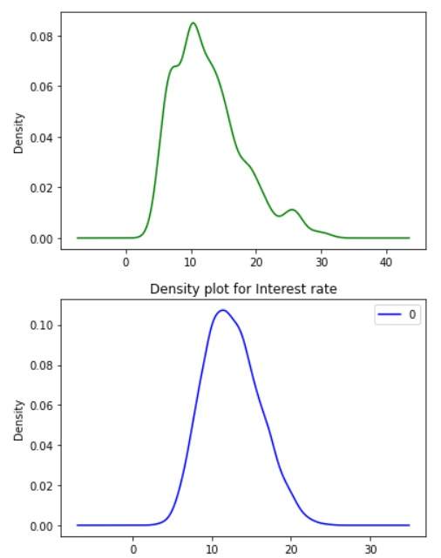
Conclusion
The interest rates vary on lot of factors - credit_line, annual_income and so on.
We were able to train the model using these essential parameters and the validation accuracy achieved was 3.55

Slide 18
Thank you !

